Slide 1
UNIT 2
THE ECOSYSTEM IS HIGHLITED HERE BECAUSE IT IS BY LEARNING HOW IT FUNCTIONS THAT WE CAN ALSO LEARN AND ADAPT FOR THE SURVIVAL OF MANKIND ON EARTH

Slide 2
UNIT 2
Ecology
Ecosystems
Laws of matter and Energy Law
Biogeochemical cycles
Hydrological cycle
Gaseous cycles
Sedentary cycles
Soil structure and functions

Slide 3
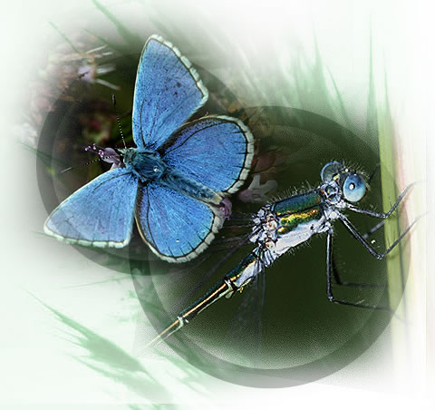
The ecosystem

Slide 4
BASIC ECOLOGICAL CONCEPTS
Ecology -The study of the structure and function of nature
Ecosystem – A self sustaining and self regulation of a community of living organisms living together and interacting with their environment
-
Environment- An aggregate of all the external conditions that tends to affect organisms both physical and biological
Population-A community of organisms of the same species
Community- A community of living organisms living and interating with each other and their environment
Ecosphere/Biosphere - The sum total of all the ecosystems in the world
Ecological niche- A species’ total role and function

Slide 5
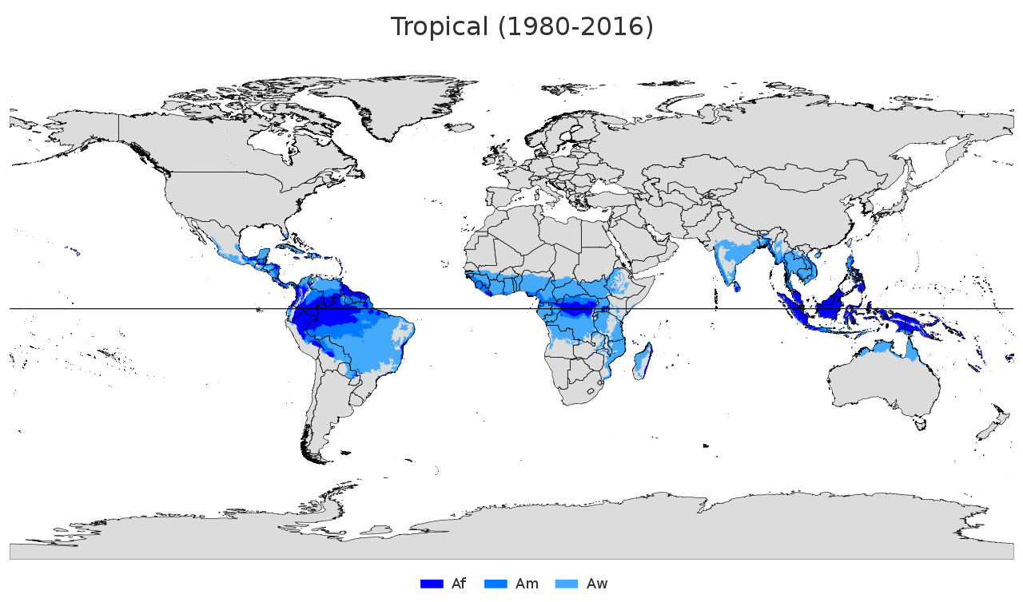
Tropical ecosystem

Slide 6
Tropical ecosystems
Tropical climates are found around the equator Latitude 25 degrees south and 24degrees North and have temperatures with temperatures of 18 degrees or higher
The tropics have the characteristics of small temperature changes and long summers. Due to the high temperature and abundant rainfall, some plants can grow throughout the year. High temperature and humidity is the most suitable environment for epiphytes to grow. Plants of all sizes can vegetate under tropical climates. Vegetations grow in layers: shrubs under tall trees, and bushes under shrubs. Almost every inch of space is being well used. Tropical plants are rich in resources, including coffee, cocoa and oil palm. Has a very species diversity index and support several plant and animal species hence the prevalent of several diseases

Slide 7
The Tropical environments
Tropical forest of standing trees
Savannah grasslands and woodlots
Deserts
The sun’s rays in the tropics are at right angles whereas it is slanted in the temperate zones.

Slide 8
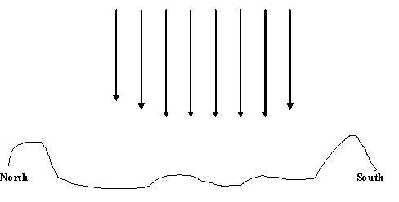
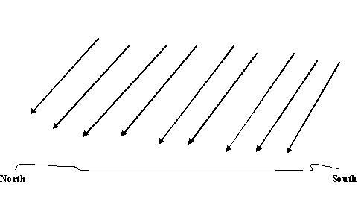
Light Rays from the Sun in the Tropics
Light rays from Sun in Temperate Latitude of Northern and Southern Hemisphere

Slide 9
Uses of the Tropical Ecosystems
Tropical crops
Sequesters of carbon dioxide
Medicinal use
Soil conservation
Timber
Fuel
Tourism
Transpiration
Clothes and Food
Biological diversity
Odour absorbing plants

Slide 10
Energy principles and laws of Energy
Matter is anything that has mass and occupies space
Energy is what is used by all living things to move matter around
To change matter from one form to the another
Work involves changing energy from one form to the other
There are 3 major laws operating in ecosystems
Notes:
Energy is used to keep matter in positions
To hold things in order
To generate power

Slide 11
The Laws of matter and energy
The Law of Conservation of Matter
The 1st Law of Energy or Thermodynamics
The 2nd Law of Energy or Thermodynamics

Slide 12
The Laws of matter and energy
The Law of Conservation of Matter- In any ordinary physical or chemical change, matter is neither created nor destroyed but merely changed from one form into the other
The 1st Law of Energy or Thermodynamics –In any ordinary physical or chemical change, energy is neither created nor destroyed but merely changed from one form into the other.
The 2nd Law of Energy or Thermodynamics-The quality of energy you put in a systems is always degraded into a low quality of energy usually in the form of heat. The entropy of the universe is always increasing

Slide 13
The Law of the conservation of matter
The law states “In any ordinary physical or chemical or physical or chemical change, matter is neither created nor destroyed but merely changed from one form into another”.
This means that whatever we think we have thrown away exists with us in one form or the other

Slide 14
1st and 2nd Laws of Energy
1st law states that in any physical or chemical change energy is neither created nor destroyed but merely changed form one form to the other Means we need energy to get energy
2nd law
This law states that The quality of energy you put in a system is always degraded into a low quality of energy which is mostly in the form of heat
This energy cannot be used to do useful work and is called entropy
Thus, entropy of the universe is thus increasing
Notes:
Lack of order = entropy
1st is also know as the law of conservation of Energy
Isolated system eg. Thermos or an insulated container
Entropy is a measure of disorder or randomness

Slide 15
1st and 2nd Laws of Energy
Normally the quality of the energy available for useful work will always be lower in quality than the initial energy.
We can recycle matter but for all practical purposes now we cannot recycle energy.

Slide 16
1st and 2nd Laws of Energy
There is an increase in entropy.
Eventually, non living objects wear out and living things die and decompose.
This process of becoming more disordered coincides with the constant flow of energy towards a dilute form of heat.
This dissipated, low quality heat has little value to us, since we are unable to use it.

Slide 17
1st and 2nd Laws of Energy
It is important to understand that energy that is of low quality from our point of view may still have significance to the world in which we live.
For example the distribution of heat energy in the ocean tends to moderate the temperature of the coastal climates.
It is unfortunate high usage of resources particularly petroleum products leads to increase in atmospheric temperature because the petroleum is reduced into low quality energy in the form of heat anytime it used .

Slide 18
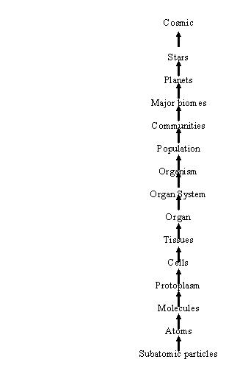
Levels Of Organisation Of Matter

Slide 19
ECOSYSTEMS
THE ECOSYSTEM
A community of organisms and their biotic environment
Involves the movement of energy and materials through the communities
Ecosystems have no definite boundaries
Forests, a lake with its biota (Flora and fauna) are also ecosystem

Slide 20
Ecological Concepts
Ecology – study of the relationship between
living organisms and with their environment.
Ecosystem is a self-sustaining and self
regulating community of organisms with their
environment.
Population is a group of plant or animal of the same species in a given locality at a given time.
Community is a group of plant and animal
populations living and interacting in a given
locality
Notes:
Ecology interaction btn organisms
ecosystem is a large community of living organisms (plants, animals and microbes) in a particular area
The living and physical components are linked together through nutrient cycles and energy flows.
Ecosystems are of any size, but usually they are in particular places.
Aquatic ecosystem, desert, forest, human ecosystem, marine ecosystem, rainforest, savanna

Slide 21
Ecosystems
Ecosystem does not only include the community of organisms but also organisms and their biotic environment, which involves the movement of energy and materials through the communities.
They are self regulating and normally have a continuous input of energy to retain its stability.
The only significant source of energy for most ecosystems is sunlight.
Notes:
Ecosystem
The main source of energy is the sun
Producers
Made up of abiotic and biotic factors interactions
They are self regulating and sustaining
They operate through laws

Slide 22
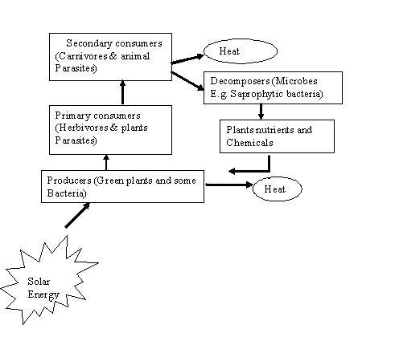
Figure 3: Basic Components of the Ecosystem

Slide 23
HABITAT
The habitat of an organism is the space that the organism occupies, the place where it lives.
It may include influences of biotic and abiotic conditions
Where it finds its food, mate etc
Notes:
Where it may function in its full capacity

Slide 24
Niche
A species total role and function in its environment
Its effects on other organisms with which it interacts
It may include where it lives or what it feeds on
Notes:
It profession
The role or function of an organism or species in an ecosystem. (ecology)
Eg. tree grows to dominate a forest canopy
Eg. Microorganism ie fungi feed on organic materials in soil breaking down complex nutrients like protein

Slide 25
Limiting factors
Every organism survival depend on chemical and physical factors
Organisms are affected by a combined action of these factors
A shortage, excess or absence of these factors can affect its number or distribution.
Such factors are known as limiting factors.
The nutrient or substances that is in shortest supply in relation to the organism demand
Notes:
Chemical factors; O2, CO2, N, P, K, N
Physical factors; Temp, precipitation etc
Eg. Nutrients
Gases such as CO2, O2
These factors are reuired in a certain amount
Eg wet bread hving fungal growth
Migratory birds as aresult of seasonal changes

Slide 26
The limiting fact principle & law
Principle deals with the degree of availability of factors , the distribution and the abundance
The law states that the existence, abundance, or distribution of an organism
can be determined by whether
The level of one or more limiting factors fall above or below the levels required by the organism
Notes:
Eg. Palm fruit grow best in west and East Africa
Orange grow best in Ghana, florida
Question; why are there so much variation in these terrestrial bodies
Ans; limiting factors

Slide 27
KINDS OF ORGANISM INTERACTIONS
Predation
A type of interaction where one organism (the predator), kills and feed on the other (prey).
The predator are adapted and highly specialised for haunting its prey
PREY
To prevent going extinct.
They breed more
Have some adaption that help them survive..
Notes:
They may have acute sense such as vision, smell, hearing
To succeed many predators employ several strategies including strength, speed and snares to overpower their prey

Slide 28
KINDS OF ORGANISM INTERACTIONS
Competition:
In this kind of interaction two organisms strive to
obtain the same limited resource.
Two types of competition
Intraspecific and Interspecific competition.
Competition among members of the same species is intraspecific
Competition between members of different species is referred to interspecific competition.
Notes:
The limited resource may be food, mate, chemical or physical conditions
Eg plants competing with the same soil nutrient

Slide 29
KINDS OF ORGANISM INTERACTIONS
Competition among members of the same spp. is a major force in shaping the evolution of a specie.
Less well –adapted individuals are more likely to die or be denied mating privileges.
The successful organisms are likely to have larger numbers of offspring.
May possess genetic characteristics that are favourable for survival of the species in that particular environment.
Notes:
Evolution is a process of gradual change
It take place over many generations
Organism change their physical characteristics

Slide 30
KINDS OF ORGANISM INTERACTIONS
Competitive Exclusion Principle
Is the concept that no two species can occupy the same ecological niche in the same place at the same time.
The more similar two species are, the more intense will be the competition between them
If one of the two is better adapted to live in the area than the other.
The less –fit species must evolve into a slightly different niche.
Migrate to a different geographic area or
Become extinct.
Notes:
The competitive Exclusion Principle is also known as Guase’s law of competive exclusion
Eg. Grey squirrels replacing the red squirrel in Britian
Disappearance of hazelnuts
Types-interference eg. Plants protecting their food from other organisms or killing them
Exploitation; plants consuming all nutrient leaving other plants with none
Eg. Birds with different beak may feed depending on shape and size of beck
Take smaller seeds , others feed on seeds

Slide 31
Symbiosis
Symbiosis
Is a close long lasting physical/biological relationship between two different species
At least one of them derives some sort of benefits from the contact / interaction.
Three types of symbiotic relationships exist:
Parasitism
Commensalism
Mutualism.
Notes:
It may occur between plants, animal or fungi
Both may benefit
Or 1 benefits and the other harmed

Slide 32
Symbiosis
Parasitism
Relationship in which one organism known as the parasite lives in or on another organism known as the host from which it derives some form of benefit e.g. Nourishment.
Two kinds of parasites occur
Endoparasites
Ectoparasites
Notes:
The parasites benefit
Parasites are normally smaller than the host.
The host generally is harmed or suffers
it is not killed immediately
They are structurally adapted to it way of life
Eg. Tapeworm
Segmented and flat-this enable them to live in the intestine of cattle, cow, humans
Types of endoparasites
Intercellular- inhibits the spaces of the body of the host
Intracellular- lives inside the cell. Eg viruses
Ectoparasites live externally on another animal- It does not kill it host
Eg. Bed bugs, head lice, tick
They are usually vectors of pathogens, transmit to host when feeding
Question; can festus or mosquitoes be consider as parasite

Slide 33
KINDS OF ORGANISM INTERACTIONS
Commensalism
Relationship between two organisms in which one organism benefits while the other is neither affected or benefit.
May not involve a long-term physical contact.
Notes:
Eg. Remora that rides attached to the sharks and other fish
The commensal does not derive it food frm d host directly
Eg2. burdock weed
They have seeds have long curved spines
These easily attached to fur of passing animals
They carry drop off to other areas
Some benefits are
Shelter, protection
Question
Name as many commensal relationships in different ecosystem

Slide 34
KINDS OF ORGANISM INTERACTIONS
Mutualism
A relationship that benefits both species involved.
Obligatory; the species cannot live without each other.
In other situations, the species can exist separately but are more successful when they are involved in a mutualistic relationship.
Notes:
E.g. Many kinds of plants such as legumes (beans, peanuts, clover etc) have bacteria that live in their roots in little nodules.
Is btn 2 dft species
Facultative mutualism; organism is not so dependent on this relationship
It can survive without it, but benefits when they come 2geda
Eg. Oxpecker and zebra
Oxpecker picks food and zebra gts pest control

Slide 35
KINDS OF ORGANISM INTERACTIONS
The roots form nodules when they are infected with certain kinds of bacteria.
The bacteria do not cause disease but provide the plants with nitrogen-containing molecules that the plant can use for growth.
Similarly, many kinds of fungi form an association with the roots of plants.
The root-fungus associations are called mycorrhizae.
Notes:
Types
Facultative; it has a free living stage in its life cycle but adopt a parasitic life when it enters a living cells
Each organism can survive independently but it benefit both to remain together
Service-resource – one provides a service and the other a resource. Eg. Honeybee
Questn; Animal feeding on plants, is it a type of parasitism
It depends; does the plant gradually dies off as a result of the feeding or goes extinct(competition)
Epiphytes
They derive moisture and nutrient from the air, rain, water and debris accumulating from the bigger plant

Slide 36
ROLES OF ORGANISMS IN ECOSYSTEM
Producers
They are mainly green plants
They use simple inorganic substances in their environment
sunlight
Water
Carbon dioxide
chlorophyll
To produce / make complex organic molecules.
They are also known as photo autotrophs
Notes:
Every ecosystem is made up of 3 component
Producers
Consumer
Decomposers
Producer eg. Plants, algae, lichens
Some inorganic substance .eg water, CO2 and sunlight
Producer also called autotrophs
Trophic is a term used to describe the level of nouishment

Slide 37
ROLES OF ORGANISMS IN ECOSYSTEM
Chemo-autotrophs
They are microorganism which can produce organic matter from chemicals
Through the Oxidation of certain chemicals in the absence of sunlight
The process is called chemosynthesis
Notes:
It occurs deep in the ocean where no sunlight exist
They make use of heat
The heat is decay of radioactive element presence in the earth core
Heat released in the ocean depths
The heat is used to convert hydrogen sulphide (H2S) and CO2 into organic cpds
Eg. Sulphur bacteria

Slide 38
Consumers:
They are organisms that require organic matter as a source of food.
They consume the organic matter to provide themselves with energy and the organic molecules necessary to build their own bodies.
They break down the organic matter to simple inorganic molecules.
Notes:
They are also knwn as heterotrophs
The obtain organic matter by feeding on plants or animals or both

Slide 39
Consumers
Based upon the way they obtain their food and the kinds of things they eat consumers can be classified as either
Primary consumers or secondary consumers
Primary consumers (herbivores) are animals that eat producers (plants and phytoplanktons) as a source of food.
Secondary Consumers (carnivore) are animals that eat other animal

Slide 40
Consumers
Omnivores
Animals that eat both plants and other animals.
Decomposers
Organisms that use non-living organic matter
as a source of energy and raw materials to build their bodies.
Whenever an organism sheds a part of itself, excretes waste products or dies, it provides a source of food for decomposers.
Decomposers are extremely important in breaking down organic matter .
Scavengers:- these animals eat carcasses eg vultures
Notes:
Question; what is the difference btn decomposers and Scavengers
Scavengers consume dead plants and animals to break down the organic matter into smaller particles
Decomposers consume the small particles produced by the scavengers

Slide 41
Decomposers
They derive their nutrient by breaking down the complex organic molecules into;
Inorganic nutrients
Notes:
Eg. Simpler Organic cpd; hydrocarbons
Inorganic nutrient do not contain carbon eg water and minerals
Organic molecules eg. Carbohydrate, protein, lipids, vitamin

Slide 42
Detritivores, saprotrophs
They feed on dead organisms, wastes of living organisms, cast-offs and partially decomposed matter
Egs. Ants, earthworms, crabs, vulture etc
They may be also known as saprotrophs, detrivores
Notes:
Detritus; decomposing plants and animals as well as faeces
They feed on the remains decomposer leave
The decomposer break down the organic material from the decaying organism
The detritivores recycle the decomposing organic material
All detrivores are decomposers but not all decomposers are detrivores
Eg. Of decomposer fungi, bacterial
Saprotroph absorb chemically digested food, digest the food eternally. Eg cheese mold, yeast

Slide 43
Trophic Levels and energy flow in Ecosystems
Each step in the flow of energy through an ecosystem is known as a trophic level.
Producers normally constitute the first trophic level
Herbivores for the second trophic level.
Carnivores that eat herbivores are the third trophic level
Carnivores that eat other carnivores as occupants
of the fourth trophic level.
Omnivores, parasites and scavengers occupy different trophic levels depending upon what they happen to be eating at the time.
Notes:
Question; diagrammatic represent the trophic levels in an ecosystem and explain

Slide 44
Trophic Levels and energy flow in Ecosystems
In ecosystems there is always the transfer of energy.
The transfer occurs in accordance with the second law of thermodynamics.
As energy flows through an ecosystem
It passes through several levels know as trophic levels.
Each trophic level contains a certain amount of energy.
Notes:
Q1

Slide 45
Trophic Levels and energy flow in Ecosystems
Each time useful energy is lost, usually as heat to the surroundings.
Therefore, in most ecosystems useful energy is lost, usually as heat to the surroundings.
It is normally difficult to actually measure the amount of energy contained in each trophic level.
One of the ways to estimate the amount of energy is to quantify the biomass.
Notes:
The biomass is the weight of living material in a trophic level.
For a simple ecosystem it is often easy to collect and weigh all the producers, herbivores and carnivores.
The weights often show the same 90% loss from one trophic level to the next as happens with the amount of energy.

Slide 46
FOOD CHAINS AND FOOD WEBS
Food Chain
A series of organisms occupying different trophic levels through which energy passes as a result of one organism consuming another.
Some food chains rely on a constant supply of small pieces of dead organic material

Slide 47
The Trophic Structure In The Ecosystem
Autotrophs: derive energy from the sun and non-living sources
Heterotrophs and decomposers: feed on preformed organic matter
Food chain/web
A food chain is simple and it shows that all life forms and all forms of food begin with sunlight and green plants

Slide 48
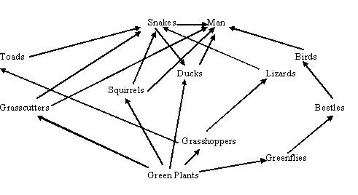
Figure 4: A typical food chain

Slide 49
Common Basis for Comparing Ecosystems
Pyramid of Numbers
The number of organisms in each level is counted
This basis for comparison is not reliable in most cases
The pyramid of biomass seems to solve the ambiguity in the pyramid of numbers

Slide 50
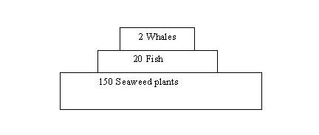
Figure 5: Pyramid of numbers

Slide 51
Question
A deer eats 25kg of herbaceous material per day. The herbaceous material is approximately 20% dry matter(DM) and has an energy content of 10MJ. (kg DM)ˉ1. Of the total energy ingested per day, 25% is excreted as undigested material. Of the 75% that is digested, 80% is lost to metabolic waste products and heat. The remaining 20% is converted to body tissue. How MJ are converted to body tissue on a daily basis? Calculate the percentage of energy consumed that is converted to body tissue
Draw a schematic of energy balance

Slide 52
Question
For every megajoule of energy used by the phytoplankton in lake Michigan. How many joules of energy are used in building cell tissue in the lake trout? How many in humans? Use the food chain path
Phytoplankton zooplankton alewife lake trout humans
Given only 10% of energy consumed is converted to biomass
Notes:
Consider mass balance.

Slide 53
Ecosystem Structure
The ecosystem has two major components:
The non-living (non biotic)
The living or biotic part
The structure of the ecosystem is directly related to energy transfer and matter recycling.

Slide 54
Non biotic portion
Energy : Solar energy drives the entire ecosystem by helping to create climate to recycle essential chemicals and to support plant life
Physical factors :
temperature
light
wind
humidity
current and
rainfall

Slide 55
Chemical :
Water
Oxygen
Carbon dioxide
Essential minerals and substances (proteins, carbohydrates, lipids, vitamins and other complex chemicals necessary for life)
The critical inorganic and organic chemicals found in air, water and soil must be recycled again several times through the ecosphere

Slide 56
Living biotic portion
Producers (Plants or autotrophs):
Plants ranging from tiny floating phytoplankton (algae, diatom etc.) in water ecosystems to giant trees
Macroconsumers (animals or heterotrophs):
Organisms who cannot manufacture their own food and must consume the preformed food compounds found in plants and animals
Decomposers (micro consumers or saprotrophs):
Tiny organisms such as bacteria that break down the bodies and complex compounds in dead animals and plants into smaller substances

Slide 57
Population versus resources
FACTORS INFLUENCING POPULATION GROWTH:
Birth
Immigration
2. FACTORS LIMITING POPULATION GROWTH
Emigration
Education
If resources that support a population are depleted, this population could become extinct.

Slide 58
What Environmental Engineering Is
The solution of problems of environmental sanitation,
Control of water,
Soil,
Atmospheric pollution, and
Social and environmental impact of these solutions
Engineering Ethics And The Environment
Environmental ethics deals with:
the attitude of people towards other living things and
towards the natural environment

Slide 59
What Environmental Engineering Is
The solution of problems of environmental sanitation,
Control of water,
Soil,
Atmospheric pollution, and
Social and environmental impact of these solutions
Engineering Ethics And The Environment
Environmental ethics deals with:
the attitude of people towards other living things and
towards the natural environment

Slide 60
Non biotic portion
Energy : Solar energy drives the entire ecosystem by helping to create climate to recycle essential chemicals and to support plant life
Physical factors :
temperature
light
wind
humidity
current and
rainfall

Slide 61
Chemical :
Water
Oxygen
Carbon dioxide
Essential minerals and substances (proteins, carbohydrates, lipids, vitamins and other complex chemicals necessary for life)
The critical inorganic and organic chemicals found in air, water and soil must be recycled again several times through the ecosphere

Slide 62
Chemical :
Water
Oxygen
Carbon dioxide
Essential minerals and substances (proteins, carbohydrates, lipids, vitamins and other complex chemicals necessary for life)
The critical inorganic and organic chemicals found in air, water and soil must be recycled again several times through the ecosphere

Slide 63
Living biotic portion
Producers (Plants or autotrophs):
Plants ranging from tiny floating phytoplankton (algae, diatom etc.) in water ecosystems to giant trees
Macroconsumers (animals or heterotrophs):
Organisms who cannot manufacture their own food and must consume the preformed food compounds found in plants and animals
Decomposers (micro consumers or saprotrophs):
Tiny organisms such as bacteria that break down the bodies and complex compounds in dead animals and plants into smaller substances

Slide 64
Climate
The average atmospheric conditions over a long period of time
Factors that make up climates :
Light
temperature,
precipitation
humidity

Slide 65
The Soil
The crucial interface between the lithosphere and all living plants that grow on its surface
The soil is made of three layers known as horizons
The A-Horizon:
Consists of freshly fallen plant litter and a sub layer of humus made up of decayed matter and some inorganic material, and other sub-layer insoluble minerals
Supports life

Slide 66
SOIL FORMATION, PROPERTIES AND PROFILE OBJECTIVES a.) Geologic process b). physical, chemical and biological factors involved in soil formation c). Soil texture and structure d). Layers in the soil profile e). Human activities and impact on soil

Slide 67
The roots of plants growing Wind and moving water Activities of organism like worms and rats burrowing Chemical weathering

Slide 68
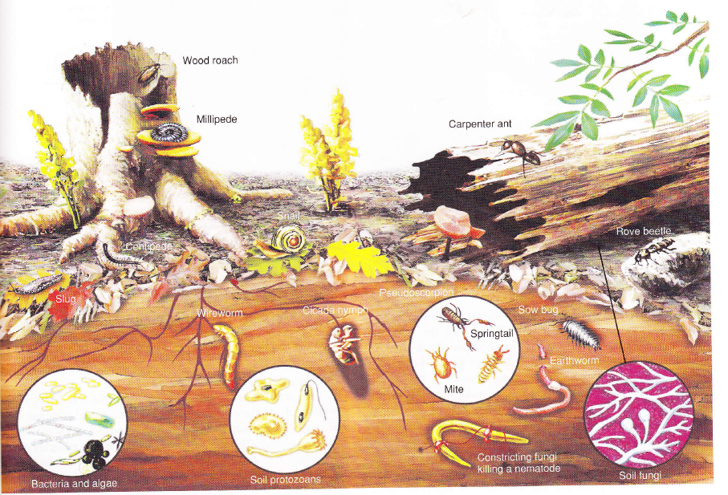
Organisms in the soil Application of pesticides destroy the organisms and weedicides destroy the ecology of the soil

Slide 69
Soil Properties
An ideal soil for agriculture use is a loam, which combines the good aeration and drainage properties of large particles with the nutrient – retention and water holding ability of clay particles.
Soil structure is different from its texture. Soil structure refers to the way various soil particles clump together. The particles in sandy soils do not attach to one another; therefore, sandy soils have a granular structure. The particles in clay soils tend to stick to one another to form large aggregates. Other soils that have a mixture of particle sizes tend to form smaller aggregates. A good soil is friable, which means that it crumbles easily. The soil structure and its moisture content determine how friable a soil is.

Slide 70
Soil Profile
The soil profile is a series of horizontal layers in the soil that differ in chemical composition, physical properties, particle size and amount of organic matter. Each recognizable layer is known as a horizon. Several systems exist for describing and classifying the horizons in soils. The uppermost layer of the soil contains more nutrients and organic matter than do the deeper layers. The top layer is known as the A horizon and consist of small mineral particles mixed with organic matter. It’s usually dark in color because of the high content of organic matter. If there is a layer of litter (undecomposed or partially decomposed organic matter) on the surface, it is known as the O- horizon. Forest soils typically have an O- horizon. Many agricultural soils do not, since the soil is worked to incorporate surface crop residue. As the organic matter decomposes, it becomes incorporated into the A horizon. The thickness of the A horizon may vary from less than one cm on steep mountain slopes to over a meter deep. Most of the living organisms and nutrients are found in the A – horizon. As water moves down through the A – horizon, it carries dissolved organic matter and minerals to lower layers in a process called leaching. Below the A horizon is a lighter coloured

Slide 71
Layer known as the B – horizon. The B-horizon, often called the subsoil contains less organic material and fewer organisms than the A – horizon. However it contains accumulations of nutrients that were leached from higher levels. B – horizon is a valuable source of nutrients for plants and it normally support a well developed root system. The area below the B-horizon is known as the C-horizon and it consists of weathered parent material. The chemical composition of the minerals of the C- horizon helps to determine the pH of the soil. The characteristics of the parent material in the C horizon may also influence the soil’s rate of water absorption and retention.

Slide 72
Chemical weathering
The chemical alteration of rock eg when rocks are exposed to the atmosphere they may undergo oxidation or hydrolysis by combining with atmospheric oxygen and/or water (acid rain), in so doing get chemically changed into different compounds.
A combination of physical, chemical and biological events acting over time is responsible for the formation of soil.

Slide 73
LAND AND SOIL
Land is the part of the world not covered by the oceans. Soil is the thin covering over the land consisting of a mixture of minerals, organic material, living organisms, air and water that together support the growth of plant life. The proportions of the soil components vary with different types of soils, but a typical ‘good’ agricultural soil is about 45% mineral, 25% air, 25% water and 5% organic matter. This combination provides good drainage, aeration and organic matter. The organic material resulting from the decay of plant and animal remains is known as humus.
Humus accumulates on the surface and ultimately becomes mixed with the top layers of mineral particles. This material contains nutrients that are taken up by plants from the soil. Humus also increases the water holding capacity and the acidity of the soil so that inorganic nutrients which are more soluble under acidic conditions, become available to plants. Humus also tends to stick other soil particles together and helps to create a loose, crumbly soil that allows water to soak in and permits air to be incorporated into the soil. Compact soils have few pore spaces, so they are poorly aerated and water has difficulty penetrating, so it runs off.

Slide 74
SOIL PROPERTIES
Soil properties include soil texture, structure, atmosphere, moisture, biotic content and chemical composition. Soil texture is determined by the size of the mineral particles within the soil. The largest soil particles are gravel, which consists of fragments larger than 2.0 millimeters in diameter. Particles between 0.05 and 2 mm are classified as sand. Silt particles range from 0.002 to 0.05mm in diameter adn the smallest particles are clay particles, which are less than 0.002 mm in diameter. Clay particles tend to be flat and are easily packed together to form layers that greatly reduce the movement of water through them. Such soils are poorly aerated and do not drain well. Clay soils in turn stay moist for longer periods of time and do not easily lose minerals to percolating water.

Slide 75
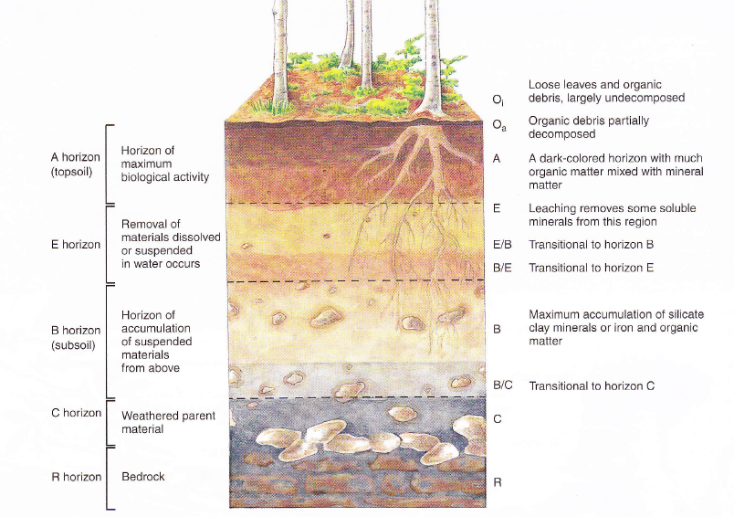
Soil Profile

Slide 76
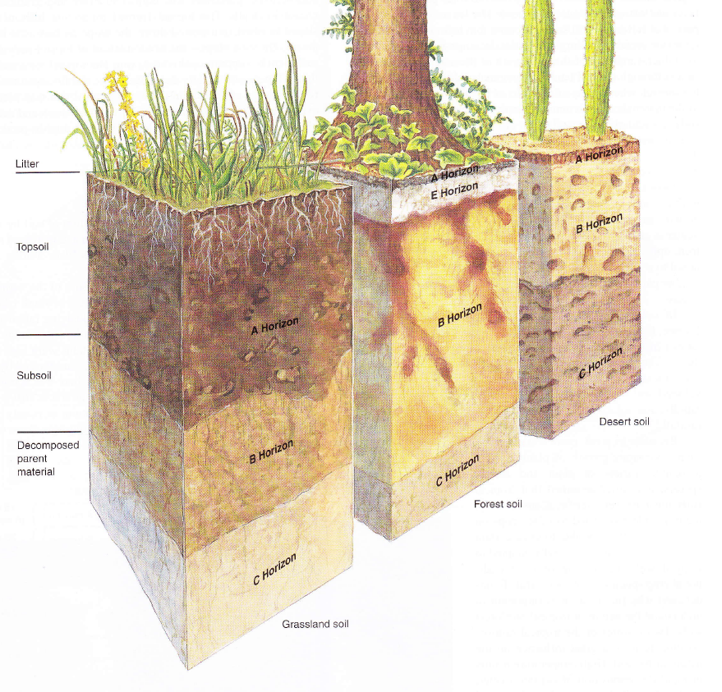
Different types of soils by ecosystem type

Slide 77
The Soil
The crucial interface between the lithosphere and all living plants that grow on its surface
The soil is made of three layers known as horizons
The O-A Horizon:
Consists of freshly fallen plant litter and a sub layer of humus made up of decayed matter and some inorganic material, and other sub-layer insoluble minerals
Supports life

Slide 78
The B-Horizon
Contains fine particles of inorganic materials such as clay and some finely divided minerals from the parent rock below
Cannot support life
The C-Horizon:
Contains the pieces of rocks broken down from the parent rock

Slide 79
The B-Horizon
Contains fine particles of inorganic materials such as clay and some finely divided minerals from the parent rock below
Cannot support life
The C-Horizon:
Contains the pieces of rocks broken down from the parent rock

Slide 80
The B-Horizon
Contains fine particles of inorganic materials such as clay and some finely divided minerals from the parent rock below
Cannot support life
The C-Horizon:
Contains the pieces of rocks broken down from the parent rock

Slide 81
Pyramid of the Biomass
Biomass measurements are based on dry weights of the organisms
Comparing food webs in fresh weights could be deceptive
It is usually expressed in g/m2 or in metric tons per hectare
Pyramid of Energy
Energy flow from one trophic level to another is not 100%
About 10% of the chemical energy available at one tropical level gets transferred to organisms at the next tropical level

Slide 82
The percentage of useful energy from one trophic level to another is called ECOLOGICAL EFFICIENCY or FOOD CHAIN EFFICIENCY
All the pyramids show the effects of the second law of thermodynamics on the flow of energy through systems
How The Ecosystem Functions
Operates through recycling of matter in accordance with the law of conservation of matter
Major cycles of matter which operate in the ecosystems are known as Biogeochemical Cycles

Slide 83
The percentage of useful energy from one trophic level to another is called ECOLOGICAL EFFICIENCY or FOOD CHAIN EFFICIENCY
All the pyramids show the effects of the second law of thermodynamics on the flow of energy through systems
How The Ecosystem Functions
Operates through recycling of matter in accordance with the law of conservation of matter
Major cycles of matter which operate in the ecosystems are known as Biogeochemical Cycles

Slide 84
The percentage of useful energy from one trophic level to another is called ECOLOGICAL EFFICIENCY or FOOD CHAIN EFFICIENCY
All the pyramids show the effects of the second law of thermodynamics on the flow of energy through systems
How The Ecosystem Functions
Operates through recycling of matter in accordance with the law of conservation of matter
Major cycles of matter which operate in the ecosystems are known as Biogeochemical Cycles

Slide 85
The percentage of useful energy from one trophic level to another is called ECOLOGICAL EFFICIENCY or FOOD CHAIN EFFICIENCY
All the pyramids show the effects of the second law of thermodynamics on the flow of energy through systems
How The Ecosystem Functions
Operates through recycling of matter in accordance with the law of conservation of matter
Major cycles of matter which operate in the ecosystems are known as Biogeochemical Cycles

Slide 86
Biogeochemical cycles
Is a pathway by which conserved matter move through biotic and abiotic component of the ecosystem through the law of conservation of matter
The abiotic can be;
hydrosphere(water)
Atmosphere(air)
Lithosphere(rocks)
Notes:
Essence of biogeochemical cycle
They transport
and store these substance so that
they can be used by living organisms
They also conserve
and recycle these chemical substance

Slide 87
Biogeochemical Cycles
Describes the convention and movement of materials by biochemical forces through the ecosphere
Matter recycling in the ecosystem is carried out by natural cycles
There are three main types of biogeochemical cycles in nature;
Gaseous Cycles
Nitrogen,
Carbon and
Oxygen cycles

Slide 88
Biogeochemical cycles
They are 3 types;
The gaseous. Eg. N, C, O₂
Hydrological. Eg. water
sedimentary cycle eg. Ca, P, S, Fe
Notes:
Gaseous biogeochemical ; has the atmosphere as it major reservoir for the atoms
Hydrological hs d ocean as it major resource

Slide 89
Hydrological Cycle
This cycle helps in exchange of water between air, land, sea, living plants and animals.
One third of the solar system absorbed by earth is used to drive the hydrological cycle
Notes:
Biogeochemical cycles is a pathway by which conserved matter move tru biotic and abiotic component of the ecosystem
The abiotic can be hydrosphere(water)
Atmosphere(air)
Lithosphere(rocks)
They transport and store these substance so that they can be used by living organisms
They also conserve and recycle these chemical substance
They are 2 types
The gaseous and the sedimentary cycle
The gaseous passes thru atmosphere and hydrosphere
The sedimentary hs the earth crust as it reservoir
Eg. Ca, S & Fe in the soil

Slide 90
Hydrological Cycle
It involves;
Massive evaporation of water from the ocean
Cloud formation
Rainfall which gives us our supply and reserves of fresh water
Depending on the temperature, it may be rain, snow or hail

Slide 91
Hydrological Cycle
When there is a good rainfall
some form run-offs
Some percolate into the soil into underground aquifers
Notes:
The runoffs flow into streams, lake, rivers , seas and other reservoirs
Those that percolate form the underground water reservoirs
They ground water are not static bt they move in all direction
Some move up through capillary to the reach of plant roots
The root absorb water by root pressure and transpirational pull
They give off water to the atmosphere thru transpiration
They move through rocks, above the rocks

Slide 92
Hydrological Cycle
Aquifers
They exist above impermeable rock strata
Underground reservoirs
These can be extracted
Notes:
By digging wells and used of pumps

Slide 93
Hydrological Cycle
Normal evaporation from the ocean exceeds precipitation by 10%
This excess 10% move as water vapour over land surface
They balance the hydrological cycle
The cycle consist of a balances constant process of evaporation, transpiration, precipitation, surface run-offs and ground water movement

Slide 94
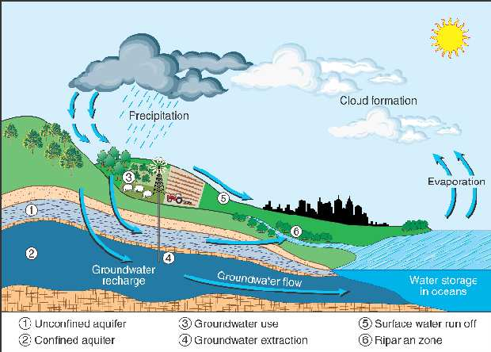

Slide 95
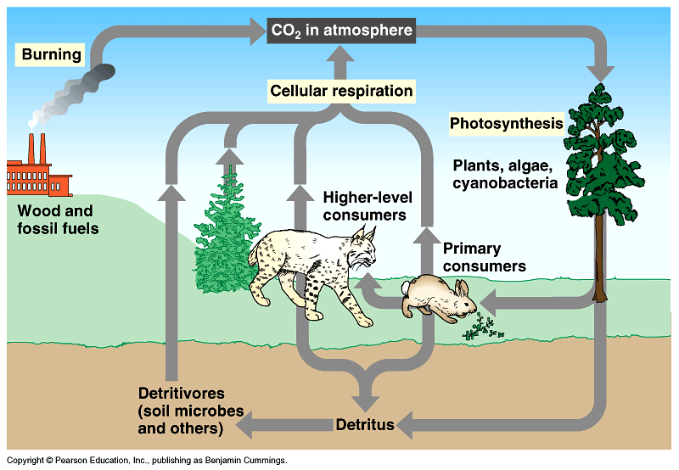
CARBON CYCLE

Slide 96
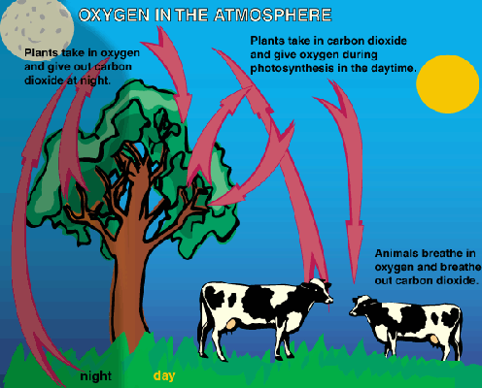
THE OXYGEN CYCLE

Slide 97
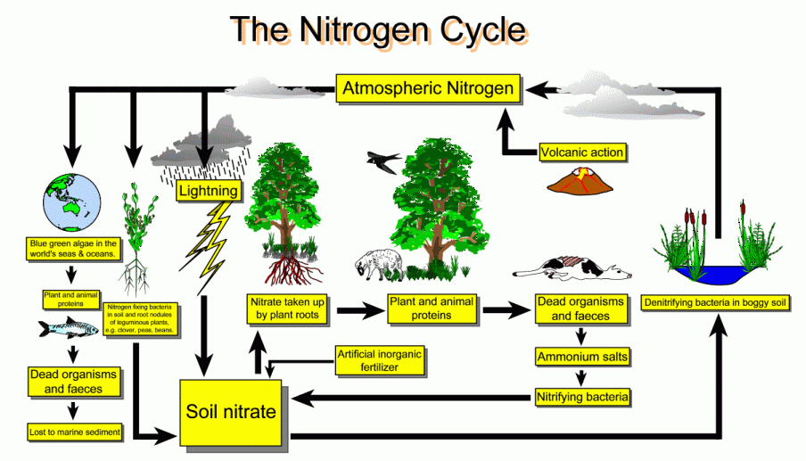

Slide 98
The Sedentary (Phosphorous) Cycle
Most of elements in the ecosystem follow the concept of the sedentary cycle where the reservoir is the soil or land eg Calcium, Potassium, Phosporous, Zinc etc
Attention is focused on phosphorous because it is becoming a limiting factor in the ecosystems
Phosphorous is not an abundant component of the ecosphere
The earth is the major reservoir of phosphorous

Slide 99
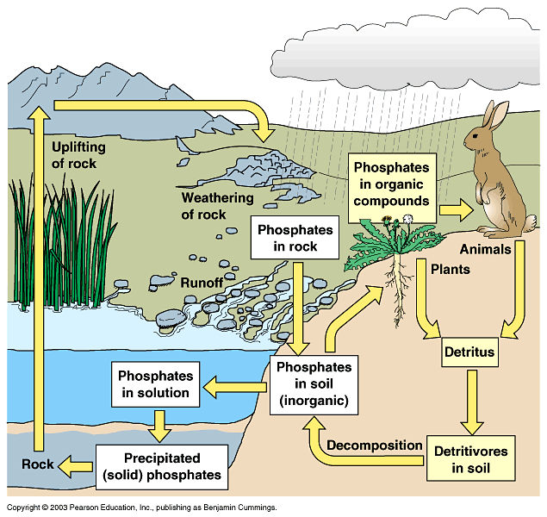

Slide 100
Phosphorous is slowly recycled from land to sea and back to the land
Phosphate is normally reduced by micro-organisms
The world as a whole will not run out of phosphorous for a long time but local and regional shortages already exists and could be getting worse

Slide 101
Limiting Factors In An Ecosystem
A limiting resource is the nutrient or substance that is in shortest supply in relation to organisms’ demand for it
An organism’s survival depends on certain chemical factors such as:
carbon dioxide,
oxygen,
Nitrogen etc. and
Certain physical factors such as:
temperature,
light,
precipitation and
humidity

Slide 102
Too much or too little of any single factor may destroy an organism or limit its numbers and distribution
The limiting factor principle
Deals with the degree of availability of factors, the distribution and abundance of an organism
Determined by whether the levels of one or more limiting factors fall above or below the levels required by the organism

Slide 103
Assignment 1
Develop an Earthmanship City which is based on matter recycling, effective social organization, pollution control, energy conservation co-operation with each other and the environment.
Describe how urban systems and natural ecosystems differ and their similarities. Debate the idea that private landowners have the right to do anything they want on their land. How is land-use decided in your community? What role do citizens have? What type of ethics is practiced? On the whole has this been on behalf of economic interests or ecological interests? From the discussion what is the future of the environment in Ghana.

Slide 104
Assignment 2
1. Describe the functions of the soil to the ecosystem
2. What is a niche in an ecosystem?
3. What is your niche in the home?
4. If the major reservoir of this element is the a) soil b) atmosphere c)water then what type of cycle is that?
5. What is a limiting factor in an ecosystem
6. Is the city of Accra an ecosystem? What will happen if there is a total lockdown with no flow of matter from external sources? How long will the human being last without food?

